Slide 1
What is an Exception?
Exception handling is essentially the ability to look for and respond to abnormal conditions that might occur during program execution
If you did not have exception handlers in the code, then the software could terminate abnormally
This could be very detrimental to the user or product if it is not handled “gracefully”
By building in exception handlers, we can try to make the code more “robust” so that it can attempt to recover and continue as normally as possible
Although it may not be able to recovery fully….
Many programming languages have built in constructs that allow the software engineer / programmer to attempt to catch likely errors
C++, Java, Ada, Python, Ruby, C#, etc

Slide 2
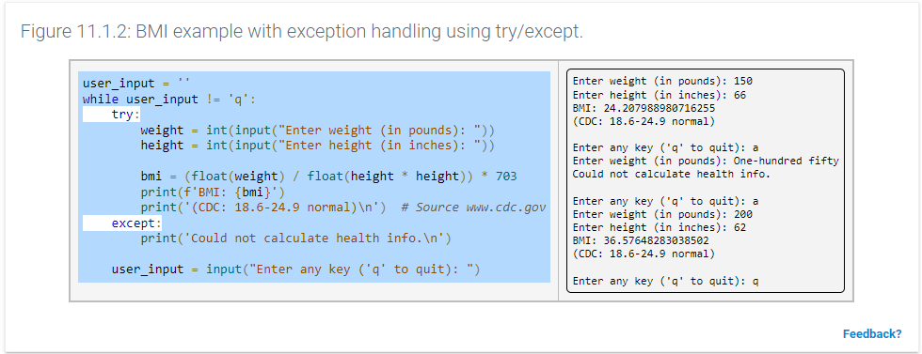

Slide 3
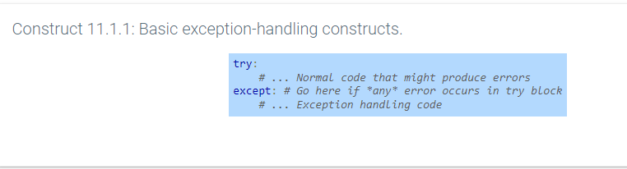
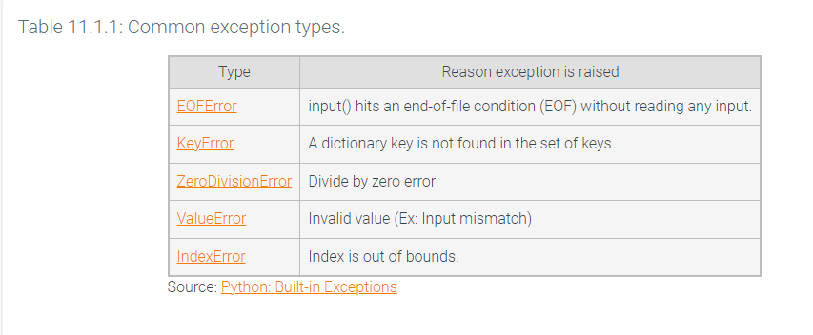

Slide 4
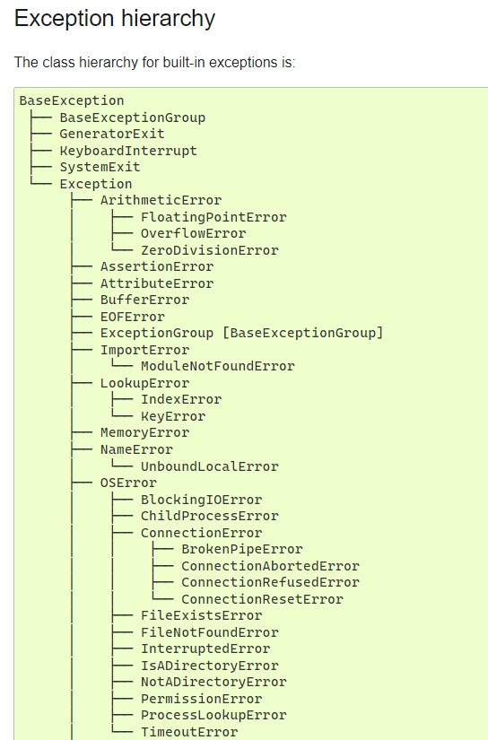
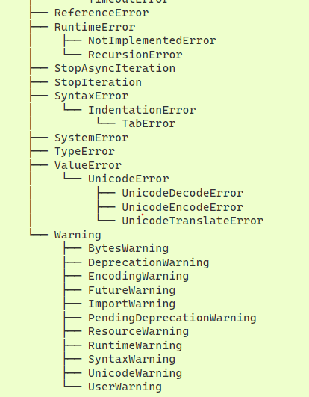
https://docs.python.org/3/library/exceptions.html

Slide 5
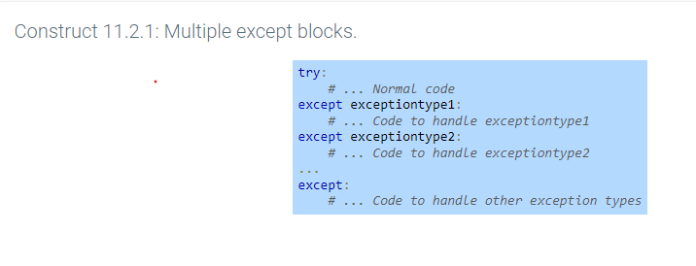
If there are no exception handlers present in the code, the Python interpreter will just print the exception that occurred and halt
A reason to handle the exception is so that the program could “try” to continue gracefully (there may still be side effects depending on what “should have” happened in the code

Slide 6
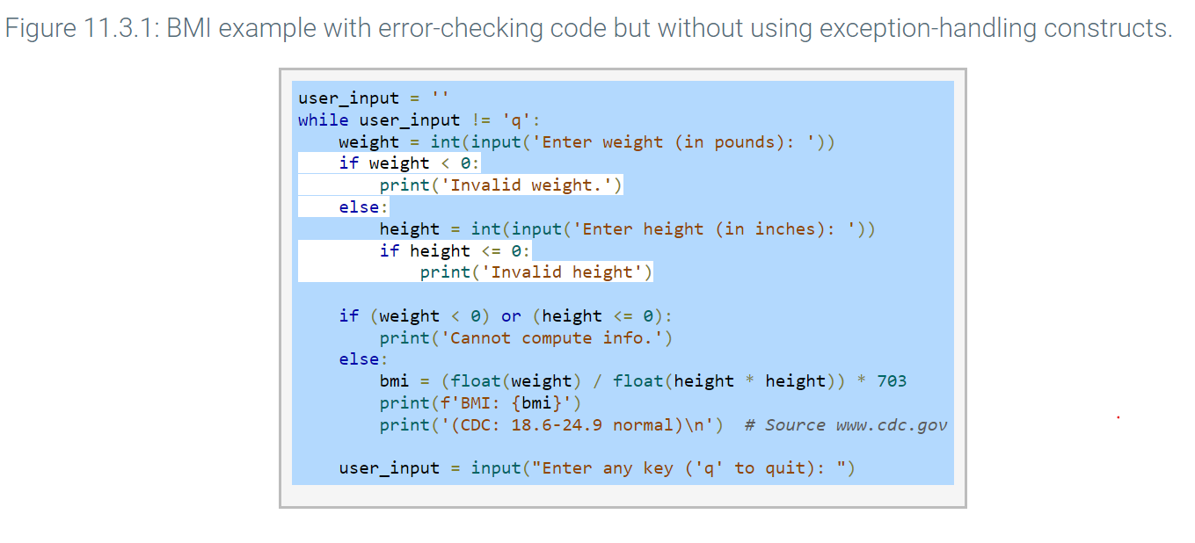

Slide 7
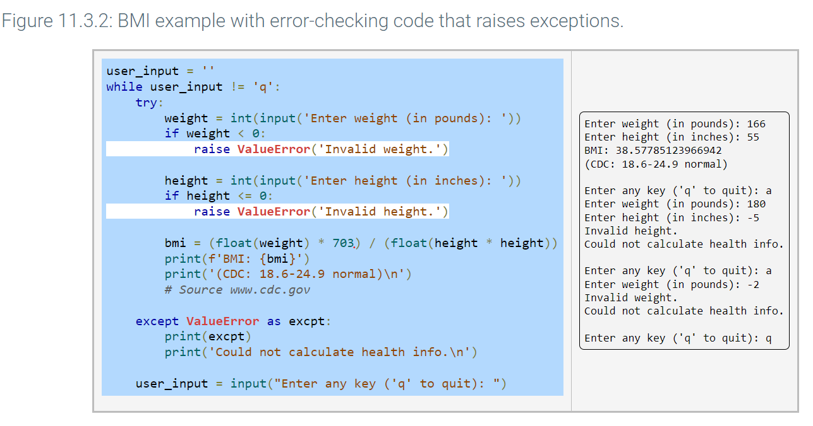

Slide 8
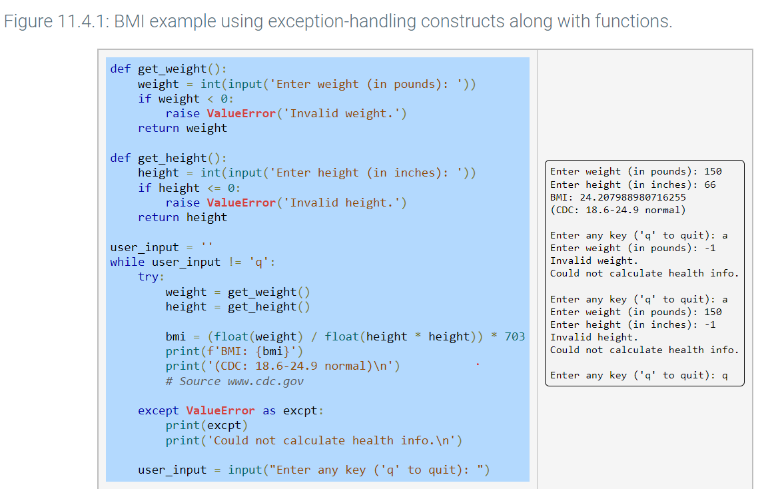

Slide 9
Let’s Do Some Labs Now!!!
Lab 11.10 – Exceptions with lists
https://learn.zybooks.com/zybook/ARIZONASFWE101Spring2023/chapter/11/section/10
Lab 11.11 – Fat Burning Heart Rate
https://learn.zybooks.com/zybook/ARIZONASFWE101Spring2023/chapter/11/section/11

Slide 10
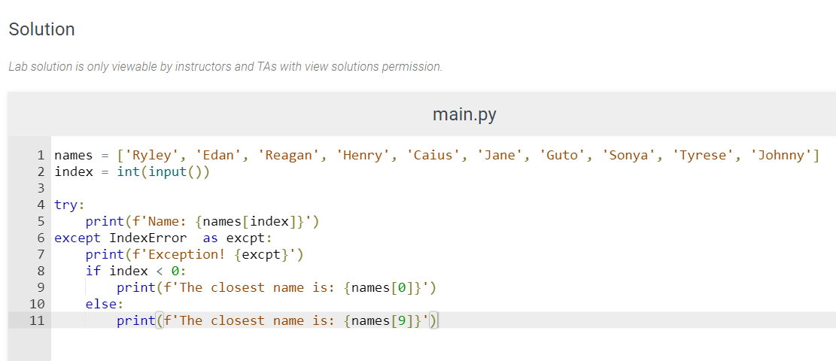
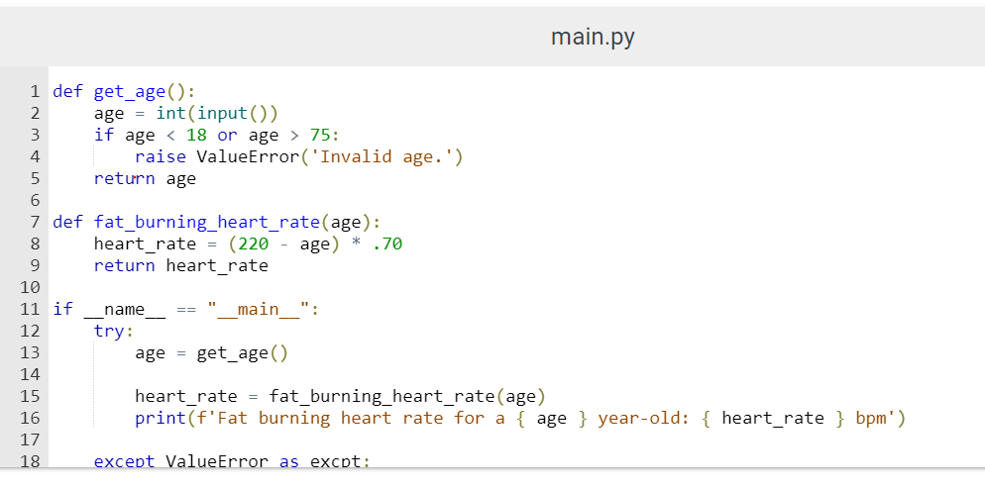
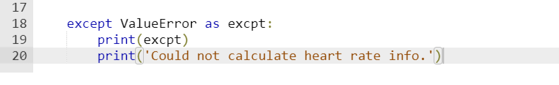
Lab 11.10 – Exceptions with lists
Lab 11.11 – Fat Burning Heart Rate

Slide 11
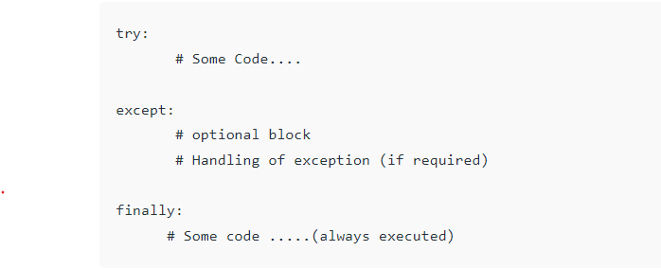
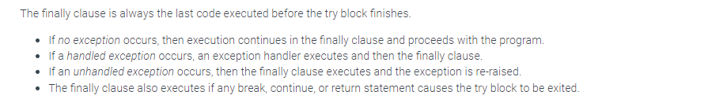
Adding in the ‘finally” clause

Slide 12
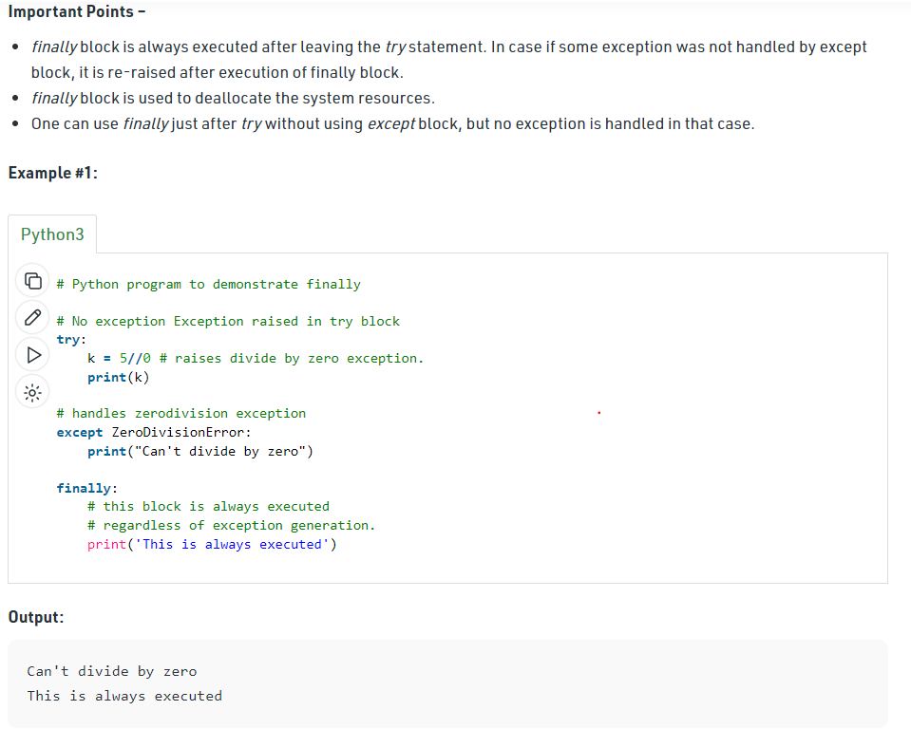

Slide 13
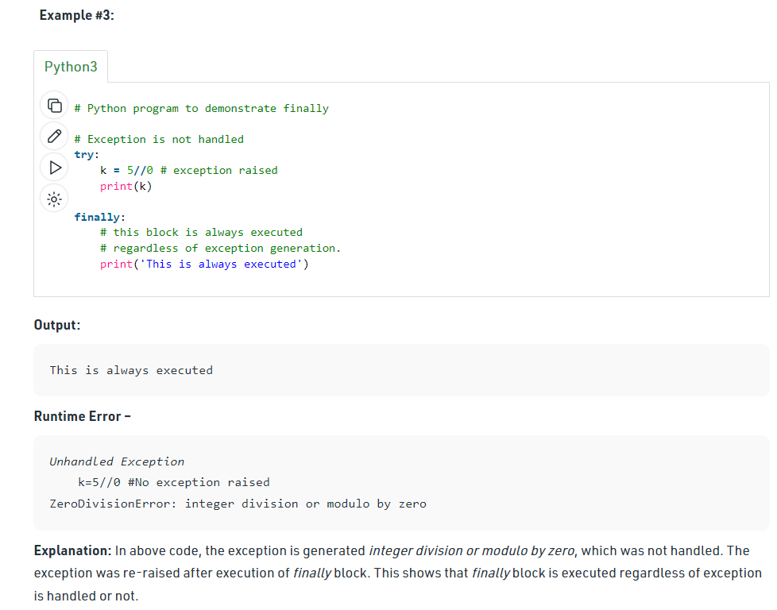
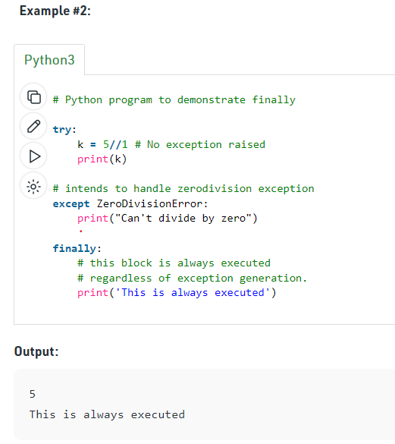

Slide 14
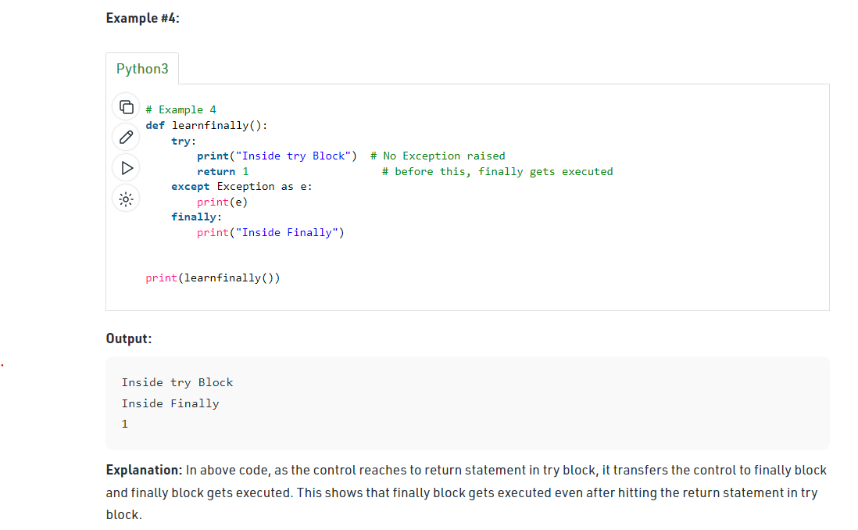

Slide 15
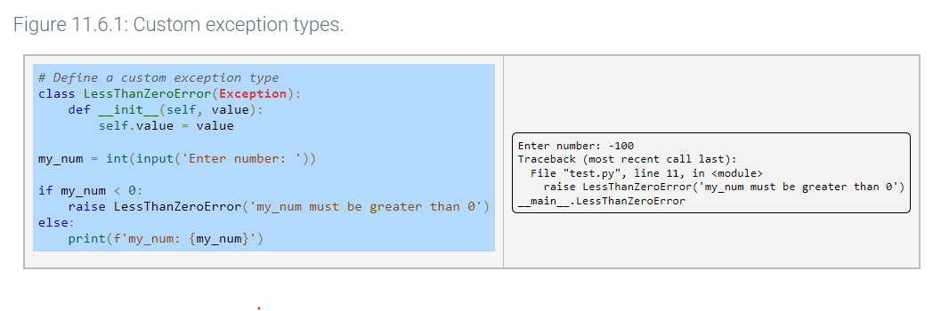
Custom Exception Types

Slide 16
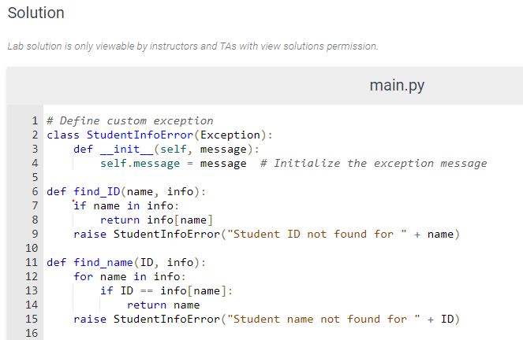
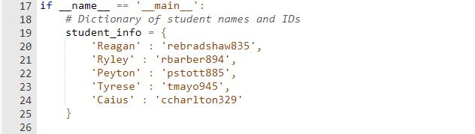
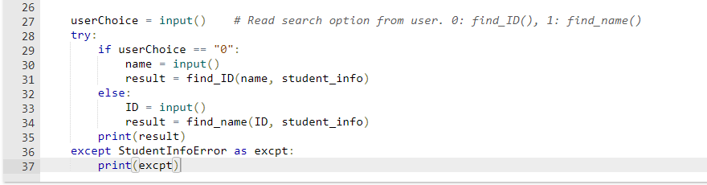

Slide 17
DebuggingTerms
Assertion. A check to make sure code isn’t doing something obviously wrong.
Breakpoint. Forces the debugger to pause.
Call Stack. Sequence of calls.
Traceback. Information returned when Python encounters an error.

Slide 18
Debugging
“Writing code accounts for 10 percent of programming. Debugging code accounts for the other 90 percent.”
So why do we debug?
Get code to run properly
We want to find and fix bugs faster with less effort

Slide 19
Raising Exceptions
*** In Class Exercise ***
Exceptions raised with a raise statement
Consists of the following:
The raise keyword
A call to the Exception() function
A string with a helpful error message passed to the Exception() function
__________________________________________________ >>> raise Exception('This is the error message.')
Traceback (most recent call last):
File "<pyshell#0>", line 1, in <module>
raise Exception('This is the error message.')
Exception: This is the error message. __________________________________________________
raise keyword and Exception() function
Resulting traceback

Slide 20
Raising Exceptions
*** In Class Exercise ***
Let’s walk through this code (1 of 2)
__________________________________________________ def goldilocksTest(temperature):
if temperature == 'just right':
print('This oatmeal is just right!')
elif temperature == 'too hot':
raise Exception('This oatmeal is too hot!')
elif temperature == 'too cold':
raise Exception('This oatmeal is too cold!') __________________________________________________
Raising exceptions

Slide 21
Raising Exceptions
*** In Class Exercise ***
Here’s the rest… (2 of 2)
__________________________________________________ #main assessment = 'too hot‘ #assessment = 'too cold‘ #assessment = 'just right‘ try: goldilocksTest(assessment) except Exception as err: print('Houston, we have a problem.') print(err) __________________________________________________
try-except

Slide 22
Getting Traceback as String
When Python encounters an error, it produces information called a traceback
Includes:
Error message
Line number of the line causing the error
Sequence of the function calls that led to the error
call stack
try-except

Slide 23
Getting Traceback as String
An example
__________________________________________________ def spam(): bacon() def bacon(): raise Exception(‘This is the error message.’) #main spam() __________________________________________________
try-except

Slide 24
Getting Traceback as String
Example’s result
--------------------------------------------------------------------------------- Traceback (most recent call last): File "ch10Work2.py", line 7, in <module> spam() File "ch10Work2.py", line 2, in spam bacon() File "ch10Work2.py", line 5, in bacon raise Exception('This is the error message.') Exception: This is the error message.
---------------------------------------------------------------------------------
try-except

Slide 25
Getting Traceback as String
We can also write traceback info to a log file
No crash, program keeps running
Import traceback module
__________________________________________________
import traceback try: raise Exception('This is the error message.') except: errorFile = open('errorInfo.txt', 'w') errorFile.write(traceback.format_exc()) errorFile.close() print('The traceback info was written to errorInfo.txt') __________________________________________________
Writing to errorInfo.txt
Where is this file saved?

Slide 26
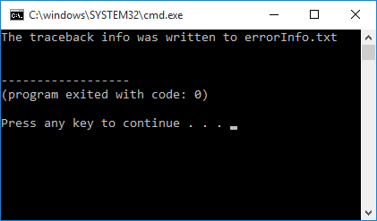
Getting Traceback as String
Here’s what the logfile (errorInfo.txt) contains
Traceback (most recent call last):
File "ch10Work2.py", line 4, in <module>
raise Exception('This is the error message.')
Exception: This is the error message.
errorInfo.txt contents

Slide 27
Assertions
An assertion is a sanity check to make sure your code isn’t doing something obviously wrong
Consists of
The assert keyword
A condition (evaluates to True or False)
A comma
A string to display when the condition is False (AssertionError exception)
Assertions are for programmer errors, not user errors
For errors that can be recovered from, raise an exception
Don’t detect with an assert statement

Slide 28
Assertions
I assert that the pod bay doors should be open…
__________________________________________________
… podBayDoor Status = ‘open’ assert podBayDoorStatus == ‘open’, ‘The pod bay doors need to be “open”.’ … __________________________________________________
What’s the result if all is ok?
Note assert

Slide 29
Assertions
What happens if we’re wrong?
__________________________________________________
podBayDoor Status = ‘closed’ assert podBayDoorStatus == ‘open’, ‘The pod bay doors need to be “open”.’ __________________________________________________
---------------------------------------------------------------------------------
Traceback(most recent call last): File“<pyshell#10>”, line 1, in <module> assert podBayDoorStatus == ‘open’, ‘The pod bay doors need to be “open”.’ AssertionError: The pod bay doors need to be “open”.
---------------------------------------------------------------------------------

Slide 30
IDLE’s Debugger
Allows you to execute your program one line at a time
Run a single line of code and wait to continue
You can examine variable values at any given point during the program’s lifetime
Easy to turn on/off in IDLE’s Shell Window
Not available in Edit Window

Slide 31
IDLE’s Debugger
Allows you to execute your program one line at a time
Run a single line of code and wait to continue
You can examine variable values at any given point in during the program’s lifetime
Easy to turn on/off in IDLE’s Shell Window
Debug menu not available in Edit Window, but…
Turn on degugger in the Shell Window and it’ll be available for programs run from Edit Window

Slide 32
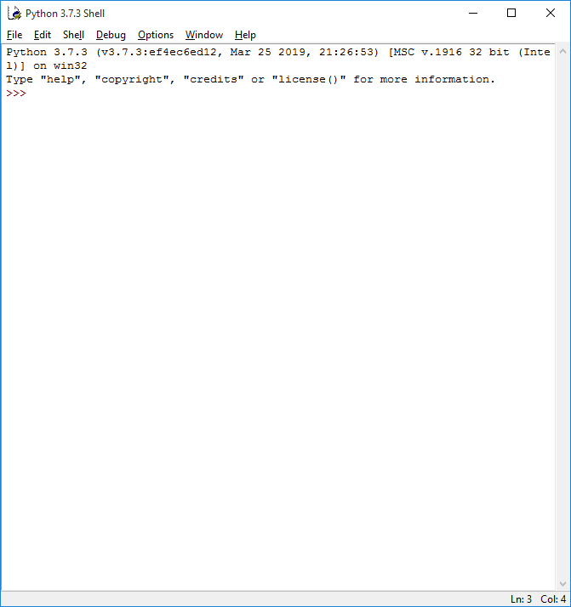
IDLE’s Debugger
*** In Class Exercise ***
The Shell Window
Note the Debug menu

Slide 33
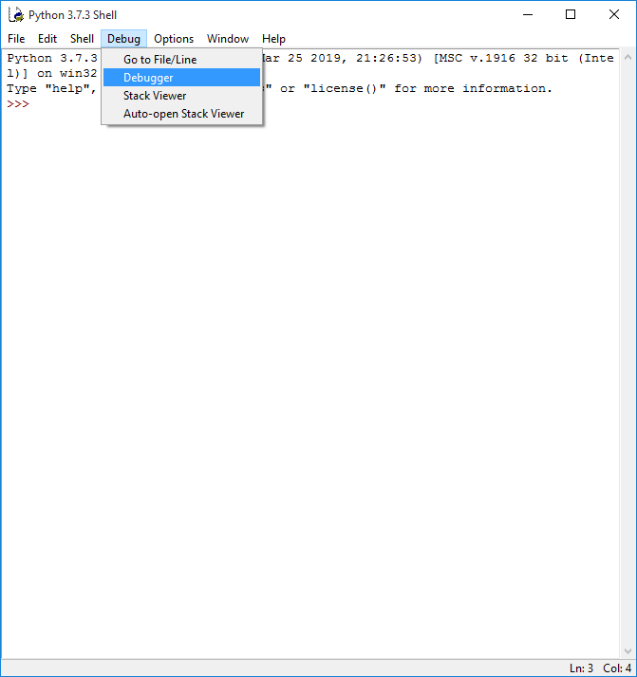
IDLE’s Debugger
*** In Class Exercise ***
Pull down the menu and select Debugger

Slide 34
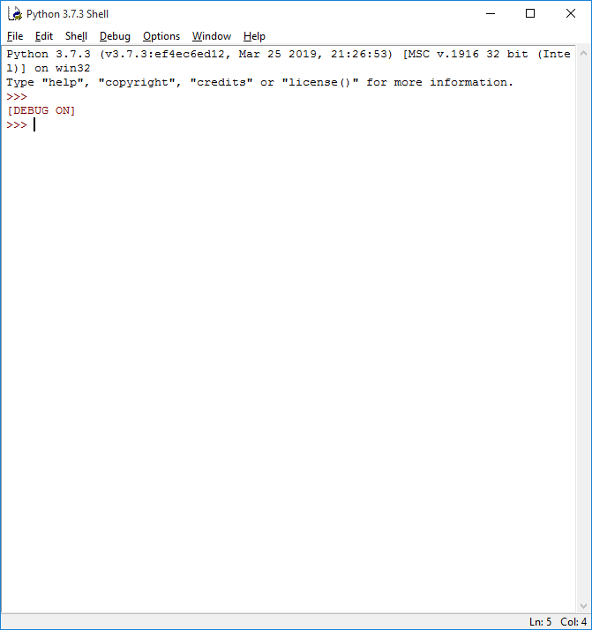
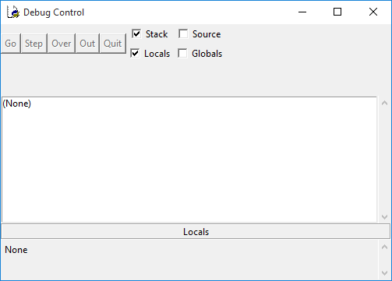
IDLE’s Debugger
*** In Class Exercise ***
Here’s what you get…

Slide 35
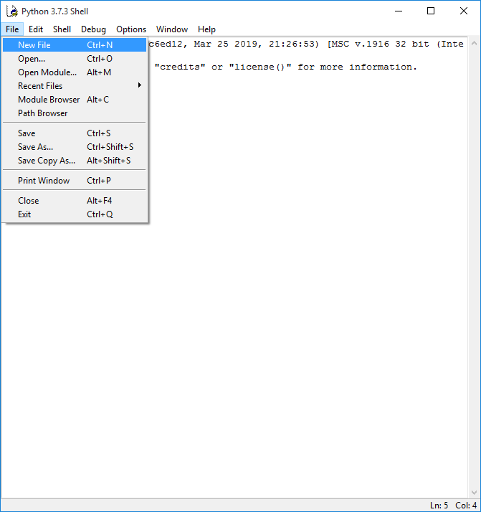
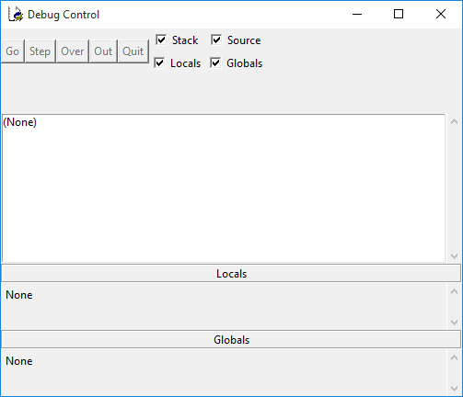
IDLE’s Debugger
*** In Class Exercise ***
Turn on source and globals
Open New File

Slide 36
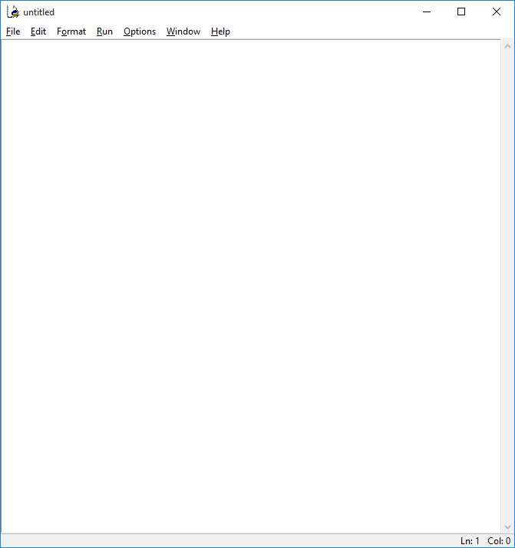
IDLE’s Debugger
*** In Class Exercise ***
Now we have an Edit Window
Debugger is turned on

Slide 37
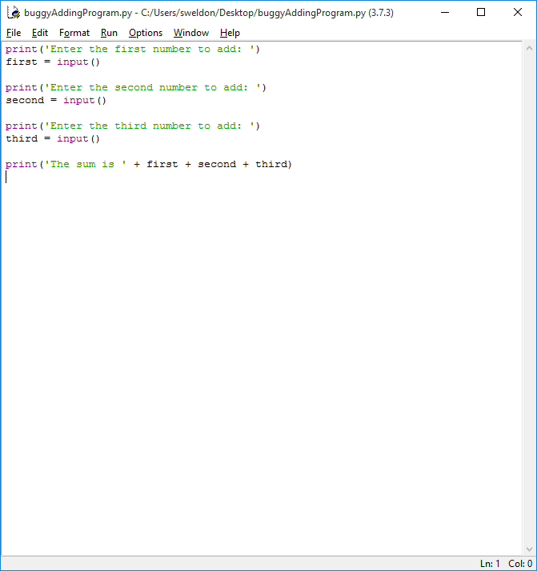
IDLE’s Debugger
*** In Class Exercise ***
Type in your code
Save your file
Run it!

Slide 38
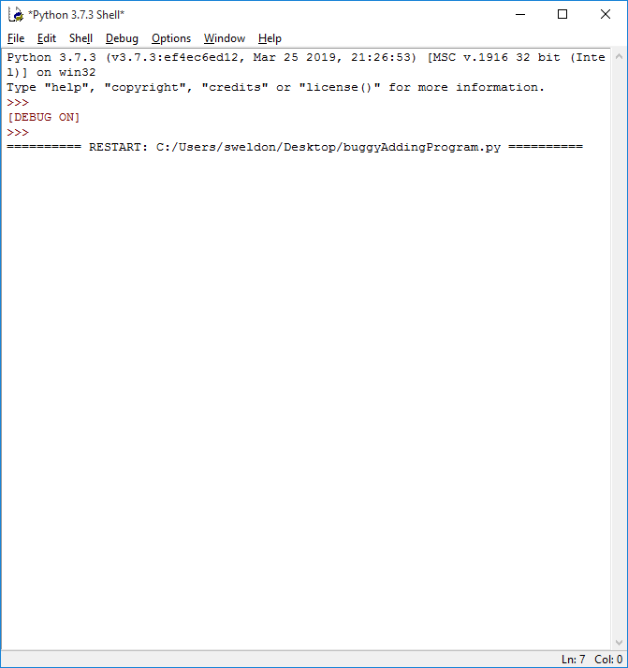
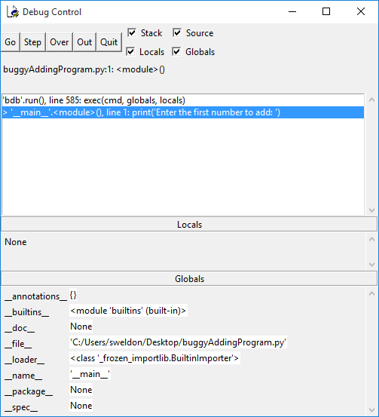
IDLE’s Debugger
*** In Class Exercise ***
Shell shows our program has started
Debug Control shows what’s going on

Slide 39
IDLE’s Debugger
Debug Control has five button options
Go
Program executes normally until terminates or reaches a breakpoint
Step
Program executes one line at a time
Over
Program executes one line at a time, but ‘steps over’ function calls
You probably don’t want to watch print() execute…

Slide 40
IDLE’s Debugger
Debug Control has five button options (cont.)
Out
Program executes at full speed until it returns from the current function
Went into print() but want out bad!
Quit
Stop debugging entirely
Immediately terminates entire program
Disable debugger if you want your program to run normally

Slide 41
Breakpoints
A breakpoint can be set on a specific line of code
Forces the debugger to pause whenever program execution reaches that line __________________________________________________
import random heads = 0 for i in range(1, 1001): if random.randint(0, 1) == 1: heads = heads + 1 if i == 500: print(‘Halfway done!’) print(‘Heads came up ‘ + str(heads) + ‘ times.’) __________________________________________________
Not the kind of program you want to step through…

Slide 42
Breakpoints
Easy to set a breakpoint
Right click on the line you want the breakpoint
Hit Set Breakpoint (Clear Breakpoint to clear)
Line will turn yellow
__________________________________________________
import random heads = 0 for i in range(1, 1001): if random.randint(0, 1) == 1: heads = heads + 1 if i == 500: print(‘Halfway done!’) print(‘Heads came up ‘ + str(heads) + ‘ times.’) __________________________________________________
Now hit Go in Debug Control; only stops when this line is executed

